Slide 1

ALGEBRA
Math 10-3

Slide 2
LESSON 7
QUADRATIC EQUATIONS

Slide 3
Definition of a Quadratic Equation
A quadratic equation in x is an equation that can be written in the standard quadratic form
ax² + bx + c = 0
where a, b and c are real numbers and a ≠ 0.
Several methods can be used to solve a quadratic equation.

Slide 4
SOLVING QUADRATIC EQUATIONS
There are four algebraic methods of solving quadratic equation in one variable, namely:
solution by factoring
solution by extraction of roots or taking square roots
solution by completing the square
solution by quadratic formula

Slide 5
SOLVING QUADRATIC EQUATIONS BY FACTORING

Slide 6
SOLVING QUADRATIC EQUATIONS BY FACTORING
For instance, if you can factor ax² + bx + c into linear factors, then ax² + bx + c = 0 can be solved by applying the following property.
The Zero Product Principle
If A and B are algebraic expressions such that AB = 0, then A = 0 or B = 0.
The zero product principle states that if the product of two factors is zero, then at least one of the factors must be zero.
In Example 1, the zero product principle is used to solve a quadratic equation.

Slide 7
SOLVE BY FACTORING
EXAMPLE
Solve each quadratic equation by factoring.
a. x² + 2x – 15 = 0 b. 2x² – 5x = 12
Solution:
a. x² + 2x – 15 = 0
(x – 3)(x + 5) = 0
x – 3 = 0 or x + 5 = 0
x = 3 x = –5
A check shows that 3 and –5 are both solutions of x² + 2x – 15 = 0.
Factor.
Set each factor equal to zero.
Solve each linear equation.

Slide 8
SOLUTION
cont’d
2x² – 5x = 12
2x² – 5x – 12 = 0
(x – 4)(2x + 3) = 0
x – 4 = 0 or 2x + 3 = 0
x = 4 2x = –3
x =
A check shows that 4 and are both solutions of
2x² – 5x = 12.
Write in standard quadratic form.
Factor.
Set each factor equal to zero.
Solve each linear equation.

Slide 9
SOLVING QUADRATIC EQUATIONS BY FACTORING
Some quadratic equations have a solution that is called a double root. For instance, consider x² – 8x + 16 = 0.
Solving this equation by factoring, we have
x² – 8x + 16 = 0
(x – 4)(x – 4) = 0
x – 4 = 0 or x – 4 = 0
x = 4 x = 4
Factor.
Set each factor equal to zero
Solve each linear equation.

Slide 10
SOLVING QUADRATIC EQUATIONS BY FACTORING
The only solution of x² – 8x + 16 = 0 is 4. In this situation,
the single solution 4 is called a double solution or double
root because it was produced by solving the two identical
equations x – 4 = 0, both of which have 4 as a solution.

Slide 11
EXERCISES: SOLVE EACH QUADRATIC EQUATIONS

Slide 12
SOLVING QUADRATIC EQUATIONS BY TAKING SQUARE ROOTS

Slide 13

SOLVING QUADRATIC EQUATIONS BY TAKING SQUARE ROOTS
Recall that This principle can be used to solve some quadratic equations by taking the square root of each side of the equation.
In the following example, we use this idea to solve x² = 25.
x² = 25
=
| x | = 5
x = –5 or x = 5
The solutions are –5 and 5.
Take the square root of each side.
Use the fact that = | x | and = 5.
Solve the absolute value equation.

Slide 14

SOLVING QUADRATIC EQUATIONS BY TAKING SQUARE ROOTS
We will refer to the preceding method of solving a quadratic equation as the square root procedure.
The Square Root Procedure
If x² = c, then x = or x = , which can also be written as
x = .
Example
If x² = 9, then x = = 3 or x = = –3.
This can be written as x = ±3.

Slide 15



SOLVING QUADRATIC EQUATIONS BY TAKING SQUARE ROOTS
If x² = 7, then x = or x = .
This can be written as x = ± .
If x² = –4, then x = = 2i or x = = –2i.
This can be written as x = ±2i.

Slide 16
SOLVE BY USING THE SQUARE ROOT PROCEDURE
EXAMPLE
Use the square root procedure to solve each equation.
a. 3x² + 12 = 0 b. (x + 1)² = 48
Solution:
a. 3x² + 12 = 0
3x² = –12
x² = –4
x =
Solve for x².
Take the square root of each side of the equation and insert a plus-or-minus sign in front of the radical.

Slide 17
SOLUTION
cont’d
x = –2i or x = 2i
The solutions are –2i and 2i.
b. (x + 1)² = 48
Take the square root of each side of the equation and insert a plus-or-minus sign in front of the radical.
Simplify.

Slide 18
SOLUTION
cont’d
The solutions are and .

Slide 19
EXERCISES: SOLVE EACH QUADRATIC EQUATIONS

Slide 20
SOLVING QUADRATIC EQUATIONS BY COMPLETING THE SQUARE

Slide 21
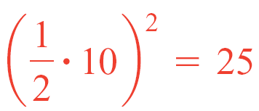
SOLVING QUADRATIC EQUATIONS BY COMPLETING THE SQUARE
Consider two binomial squares and their perfect-square trinomial products.
In each of the preceding perfect-square trinomials, the coefficient of x² is 1 and the constant term is the square of half the coefficient of the x term.
x² + 10x + 25,

Slide 22
SOLVING QUADRATIC EQUATIONS BY COMPLETING THE SQUARE
x² – 6x + 9,
Adding to a binomial of the form x² + bx the constant term that makes the binomial a perfect-square trinomial is called completing the square.
For example, to complete the square of x² + 8x, add
to produce the perfect-square trinomial x² + 8x + 16.

Slide 23
SOLVING QUADRATIC EQUATIONS BY COMPLETING THE SQUARE
Completing the square is a powerful procedure that can be used to solve any quadratic equation.
For instance, to solve x² – 6x + 13 = 0, first isolate the variable terms on one side of the equation and the constant term on the other side.
x² – 6x = –13
x² – 6x + 9 = –13 + 9
Subtract 13 from each side of the equation.
Complete the square by adding
to each side of the
equation.

Slide 24
SOLVING QUADRATIC EQUATIONS BY COMPLETING THE SQUARE
(x – 3)² = –4
x – 3 =
x – 3 = ±2i
x = 3 ± 2i
The solutions of x² – 6x + 13 = 0 are 3 – 2i and 3 + 2i.
You can check these solutions by substituting each solution into the original equation.
Factor and solve by the square root procedure.

Slide 25
SOLVING QUADRATIC EQUATIONS BY COMPLETING THE SQUARE
For instance, the following check shows that 3 – 2i does satisfy the original equation.
x² – 6x + 13 = 0
(3 – 2i )² – 6(3 – 2i ) + 13 ≟ 0
9 – 12i + 4i ² – 18 + 12i + 13 ≟ 0
4 + 4(–1) ≟ 0
0 = 0
Substitute 3 – 2i for x.
Simplify.
The left side equals the right side, so 3 – 2i checks.

Slide 26
SOLVE BY COMPLETING THE SQUARE
Solve x² = 2x + 6 by completing the square.
Solution:
x² = 2x + 6
x² – 2x = 6
x² – 2x + 1 = 6 + 1
(x – 1)² = 7
Isolate the constant term.
Complete the square.
Factor and simplify.

Slide 27


SOLUTION
cont’d
x – 1 =
x = 1
The exact solutions of x² = 2x + 6 are and .
A calculator can be used to show that
and
The decimals –1.646 and 3.646 are approximate solutions of x² = 2x + 6.
Apply the square root procedure.
Solve for x.

Slide 28
SOLVE BY COMPLETING THE SQUARE
Completing the square by adding the square of half the coefficient of the x term requires that the coefficient of the x² term be 1.
If the coefficient of the x² term is not 1, then first multiply each term on each side of the equation by the reciprocal of the coefficient of x² to produce a coefficient of 1 for the x² term.

Slide 29
EXERCISES: SOLVE EACH QUADRATIC EQUATIONS

Slide 30
SOLVING QUADRATIC EQUATIONS BY USING THE QUADRATIC FORMULA

Slide 31
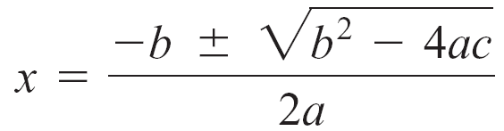
SOLVING QUADRATIC EQUATIONS BY USING THE QUADRATIC FORMULA
Completing the square for ax² + bx + c = 0 (a ≠ 0) produces a formula for x in terms of the coefficients a, b, and c.
The formula is known as the quadratic formula, and it can be used to solve any quadratic equation.
The Quadratic Formula
If ax² + bx + c = 0, a ≠ 0, then
As a general rule, you should first try to solve quadratic equations by factoring. If the factoring process proves difficult, then solve by using the quadratic formula.

Slide 32
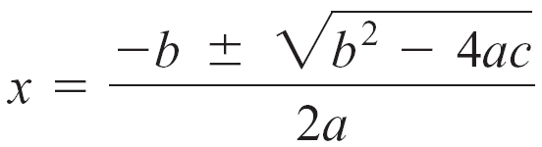
SOLVE BY USING THE QUADRATIC FORMULA
Use the quadratic formula to solve each of the following.
a. x² = 3x + 5 b. 4x² – 4x + 3 = 0
Solution:
a. x² = 3x + 5
x² – 3x – 5 = 0
Write the equation in standard form.
Use the quadratic formula.
a = 1, b = –3, c = – 5.

Slide 33
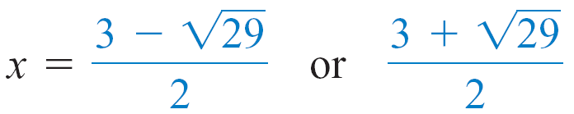
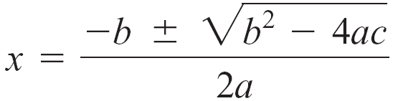
SOLUTION
cont’d
The solutions are and .
b. 4x² – 4x + 3 = 0
The equation is in standard
form.
Use the quadratic formula.

Slide 34
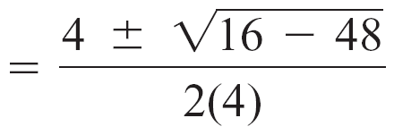
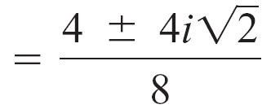
SOLUTION
cont’d
a = 4, b = –4, c = 3.

Slide 35
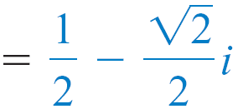
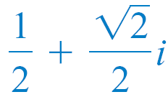
SOLUTION
cont’d
The solutions are and .

Slide 36
EXERCISES: SOLVE EACH QUADRATIC EQUATIONS

Slide 37
THE DISCRIMINANT OF A QUADRATIC EQUATION

Slide 38
THE DISCRIMINANT OF A QUADRATIC EQUATION
The solutions of ax² + bx + c = 0, (a ≠ 0), are given by
The expression under the radical, b² – 4ac, is called the discriminant of the equation ax² + bx + c = 0.
If b² – 4ac ≥ 0, then is a real number.
If b² – 4ac < 0, then is not a real number.
Thus the sign of the discriminant can be used to determine whether the solutions of a quadratic equation are real numbers.

Slide 39
THE DISCRIMINANT OF A QUADRATIC EQUATION
The Discriminant and the Solutions of a Quadratic Equation
The equation ax² + bx + c = 0, with real coefficients and a ≠ 0, has as its discriminant b² – 4ac.
If b² – 4ac > 0, then ax² + bx + c = 0 has two distinct real solutions.
If b² – 4ac = 0, then ax² + bx + c = 0 has one real solution. The solution is a double solution.
If b² – 4ac < 0, then ax² + bx + c = 0 has two distinct nonreal complex solutions. The solutions are conjugates of each other.

Slide 40
USE THE DISCRIMINANT TO DETERMINE THE NUMBER OF REAL SOLUTIONS
For each equation, determine the discriminant and state the number of real solutions.
a. 2x² – 5x + 1 = 0
b. 3x² + 6x + 7 = 0
c. x² + 6x + 9 = 0

Slide 41
SOLUTION
a. The discriminant of 2x² – 5x + 1 = 0 is
b² – 4ac = (–5)² – 4(2)(1)
= 17.
Because the discriminant is positive,
2x² – 5x + 1 = 0 has two distinct real solutions.
b. The discriminant of 3x² + 6x + 7 = 0 is
b² – 4ac = 6² – 4(3)(7)
= –48.
Because the discriminant is negative,
3x² + 6x + 7 = 0 has no real solutions.

Slide 42
SOLUTION
cont’d
c. The discriminant of x² + 6x + 9 = 0 is
b² – 4ac = 6² – 4(1)(9)
= 0.
Because the discriminant is 0,
x² + 6x + 9 = 0 has one real solution.

Slide 43
EXERCISES: DETERMINE THE NATURE OF ROOTS OF EACH QUADRATIC EQUATIONS.

Slide 44
EQUATIONS IN QUADRATIC FORM (OTHER TYPES)
In solving equations in quadratic form, use the following steps:
1.Rewrite the equation in quadratic form using a substitute variable.
2. Solve the resulting quadratic equation for the substitute variable.
3. Replace the substitute variable with the original variable and solve.
. Check your answer in the original equation.

Slide 45
SOLVE EACH QUADRATIC EQUATION.

Slide 50
SUM AND PRODUCT OF ROOTS
Recall from the quadratic formula that when

Slide 51
SUM OF ROOTS
Sum of roots = r + s

Slide 52
PRODUCT OF ROOTS
Product of roots = (r) (s)

Slide 53
EXAMPLE
DETERMINE THE VALUE OF K THAT SATISFIES THE GIVEN CONDITION

Slide 54
FINDING THE QUADRATIC EQUATION GIVEN THE ROOTS
Example: Find the quadratic equations with the given roots.

Slide 55
APPLICATIONS OF QUADRATIC EQUATIONS

Slide 56
APPLICATIONS OF QUADRATIC EQUATIONS
A right triangle contains one 90° angle. The side opposite the 90° angle is called the hypotenuse. The other two sides are called legs.
The lengths of the sides of a right triangle are related by a theorem known as the Pythagorean Theorem.
The Pythagorean Theorem states that the square of the length of the hypotenuse of a right triangle is equal to the sum of the squares of the lengths of the legs.
This theorem is often used to solve applications that involve right triangles.

Slide 57
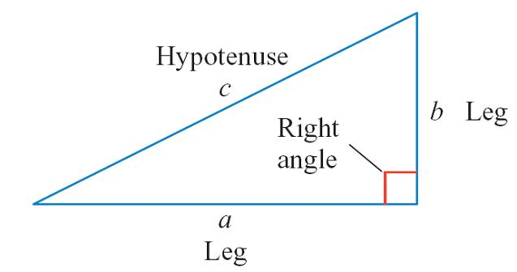
APPLICATIONS OF QUADRATIC EQUATIONS
The Pythagorean Theorem
If a and b denote the lengths of the legs of a right triangle and c the length of the hypotenuse, then c² = a² + b² .

Slide 58
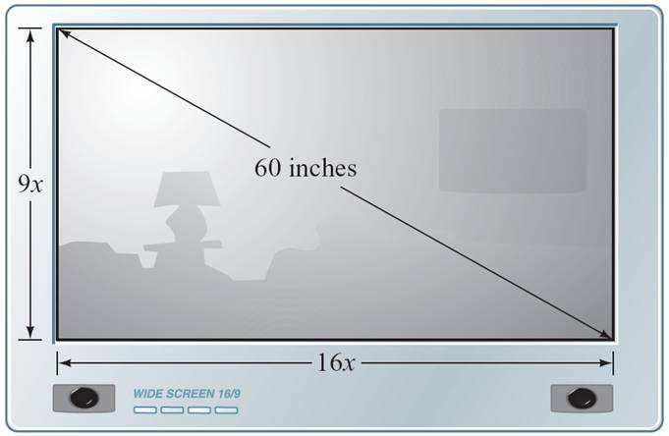
APPLICATIONS OF QUADRATIC EQUATIONS
EXAMPLE
A television screen measures 60 inches diagonally, and its aspect ratio is 16 to 9. This means that the ratio of the width of the screen to the height of the screen is 16 to 9. Find the width and height of the screen.
A 60-inch television screen with a 16:9 aspect ratio.

Slide 59
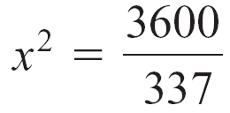
SOLUTION
Let 16x represent the width of the screen and let 9x represent the height of the screen.
Applying the Pythagorean Theorem gives us
(16x)² + (9x)² = 60²
256x² + 81x² = 3600
337x² = 3600
Solve for x.

Slide 60
SOLUTION
cont’d
≈ 3.268 inches
The height of the screen is about 9(3.268) ≈ 29.4 inches, and the width of the screen is about 16(3.268) ≈ 52.3 inches.
Apply the square root procedure. The plus-or-minus sign is not used in this
application because we know x is positive.

Slide 61
APPLICATIONS OF QUADRATIC EQUATIONS
Quadratic equations are often used to determine the height (position) of an object that has been dropped or projected.
For instance, the position equation s = –16t ² + v₀t + s₀ can be used to estimate the height of a projected object near the surface of Earth at a given time t in seconds.
In this equation, v₀ is the initial velocity of the object in feet per second and s₀ is the initial height of the object in feet.

Slide 62
APPLICATIONS OF QUADRATIC EQUATIONS
SOLVE THE FOLLOWING PROBLEMS.
The product of two consecutive positive integers is 56. Find the lowest integer. ans. 7
2. Paul can finish a job in 2 hrs less than John. Working together they can finish it in 2 hours and 24 minutes. How long would it take Paul to
finish the job working alone? ans. 4 hours
3.The length of a rectangle is five more than twice its width. The area of the rectangle is 52 sqm. Find the dimensions of the rectangle. ans. 4 and 13
4.A tank can be filled in 2 hours by 2 pipes together. The larger pipe can
fill it in 3 hours less than the smaller. How long will it take each pipe to
fill the tank? ans. 6 and 3

Slide 63
APPLICATIONS OF QUADRATIC EQUATIONS
A car traveled the first 100 kilometers of a trip at one speed and the last 135 kilometers at an average of 5 kilometers per hour less. If the entire trip took 5 hours, what was the average speed of the car for the first part of the trip? ans. 50 kph
Find a number whose square exceeds 14 times the number by 51.
The denominator of a fraction is 1 more than the
numerator. When 5/6 is added to the fraction, the terms
of the fraction are reversed. What is the original fraction?
A boy can row 16 kilometers downstream and return a
distance of 16 kilometers upstream in 5 hours. If the rate
of the current is 6 km/hr, what is the boy’s rate of rowing in
still water?

Slide 64
APPLICATIONS OF QUADRATIC EQUATIONS
A box is to be formed from a rectangular piece of wood by
cutting equal squares of 10 inches out of the corners and
folding the sides. The piece of wood is thrice as long as it
is wide. If the volume of the box is 7680 in³, What are the
dimensions of the original piece of wood?
The science club bought a Php 2400 worth of apparatus for their experiment. If there had been 8 more students in the club, then the cost per member to buy the apparatus would have been Php 10 less. How many students are in the club?

